Slide 1
Week 10 – Diffusion language models 3
Mastering Diffusion
Yejoon Lee
AIDAS Lab
Seoul National University
leeyejoon@snu.ac.kr

Slide 2
Table of contents
Sampling
  Basic DLM sampling (non-AR)
  Semi-AR sampling & approximate KV caching
  Block diffusion (AR-diffusion hybrid)
Post-training
  Diffusion-of-thought
  GRPO for DLM (d1)

Slide 3
DLM Sampling

Slide 4
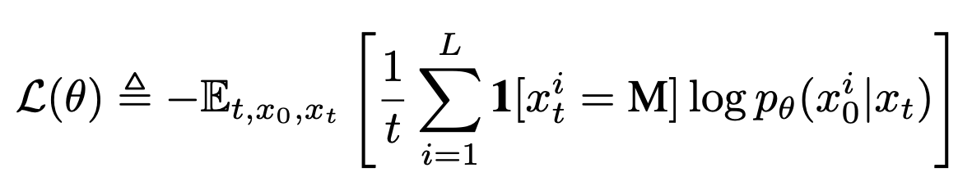

Review: Masked Diffusion Language Model (MDLM)
MDLM loss is a NLL on masked tokens
This loss is an upper bound of NLL of data, just like the generative models we’ve seen
Throughout this talk, Diffusion Language Model(DLM) means MDLM
Nie et al., 2025, Large Language Diffusion Models.

Slide 5
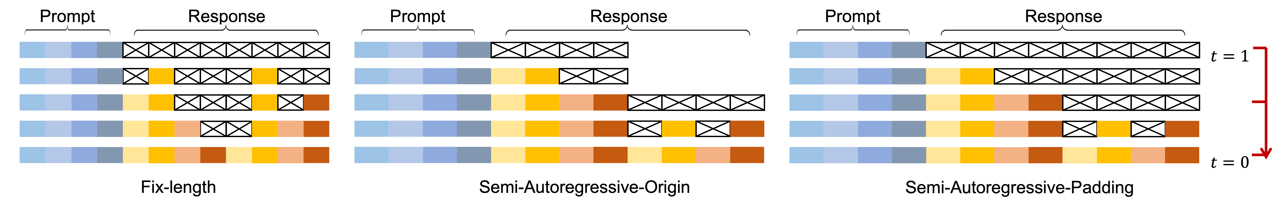
Three flavors of sampling DLM
In DLM, we can define “block” and the tokens are sampled block-by-block
LLaDA mentions three flavors of DLM sampling.
It may seem that the right two are more similar than the other…
https://github.com/ML-GSAI/LLaDA/blob/main/GUIDELINES.md

Slide 6
Three flavors of sampling DLM
In DLM, we can define “block” and the tokens are sampled block-by-block
LLaDA mentions three flavors of DLM sampling.
By the end you will know that the middle one is the distinct one
https://github.com/ML-GSAI/LLaDA/blob/main/GUIDELINES.md

Slide 7
Table of contents
Sampling
  Basic DLM sampling (non-AR)
  Semi-AR sampling & approximate KV caching
  Block diffusion (AR-diffusion hybrid)

Slide 8
<M> | <M> | <M> | <M> | <M> | <M>
t=1
<M> | <M> | A | <M> | <M> | <M>
Token “A” stays the same,
but the forward pass is not identical
<M> | <M> | A | <M> | <M> | B
<M> | <M> | A | <M> | C | B
.
.
.
F | D | A | E | C | B
t=0

Slide 9


















Inside the forward pass,
<M> | <M> | A | <M> | <M> | <M>
t=5/6
$$h_{A}$$
$${kv}_{0}$$
$${kv}_{1}$$
$$q_{2}$$
$${kv}_{2}$$
$${kv}_{3}$$
$${kv}_{4}$$
$${kv}_{5}$$
Layer 1
$$o_{2}$$
$$h_{2}^{(2)}$$
Layer 2
$$q_{2}^{(2)}$$
$${kv}_{2}^{(2)}$$
.
.
.
Logits
$$l_{1}$$
$$l_{2}$$
$$l_{3}$$
$$l_{4}$$
$$l_{5}$$
$$l_{6}$$
6th token is chosen to be unmasked
(e.g., via random or confidence)
Rest of the logits are ignored
argmax
<M> | <M> | A | <M> | <M> | B
t=4/6
Unmasked token stays the same

Slide 10







<M> | <M> | A | <M> | <M> | B
$$h_{A}$$
$${kv}_{0}$$
$${kv}_{1}$$
$$q_{2}$$
$${kv}_{2}$$
$${kv}_{3}$$
$${kv}_{4}$$
$${kv}_{5}$$
KV of 6th token has changed from <M> to B
Layer 1
After attention with $kv_{5}$, all the proceeding results change
$$o_{2}$$
$$h_{2}^{(2)}$$
Layer 2
$$q_{2}^{(2)}$$
$${kv}_{2}^{(2)}$$
.
.
.
Logits
$$l_{1}$$
$$l_{2}$$
$$l_{3}$$
$$l_{4}$$
$$l_{5}$$
$$l_{6}$$
<M> | <M> | A | <M> | C | B

Slide 11

<M> | <M> | <M> | <M> | <M> | <M>
t=1
<M> | <M> | A | <M> | <M> | <M>
KV of token A
$$≠$$
<M> | <M> | A | <M> | <M> | B
KV of token A
<M> | <M> | A | <M> | C | B
.
.
.
F | D | A | E | C | B
t=0

Slide 12
<M> | <M> | <M> | <M> | <M> | <M>
t=1
<M> | <M> | A | <M> | <M> | <M>
KV of token <M>
$$≠$$
<M> | <M> | A | <M> | <M> | B
KV of token <M>
<M> | <M> | A | <M> | C | B
.
.
.
F | D | A | E | C | B
t=0

Slide 13
P | R | <M> | <M> | <M> | <M>
t=1
P | R | A | <M> | <M> | <M>
KV of token R
$$≠$$
P | R | A | <M> | <M> | B
KV of token R
P | R | A | <M> | C | B
.
.
.
Input tokens(prompts) are fed as input, across all timesteps
There is no such thing as “prefill” or “KV caching”
P | R | A | D | C | B
t=0

Slide 14
Semi-AR sampling
& approximate KV caching

Slide 15
Block 1
Introducing semi-AR sampling:
Only the tokens in current block
can be unmasked.
t=1
<M> | <M> | <M> | <M> | <M> | <M>
<M> | A | <M> | <M> | <M> | <M>
Block 2
B | A | <M> | <M> | <M> | <M>
B | A | C | <M> | <M> | <M>
Block 3
B | A | C | D | <M> | <M>
.
.
.
F | D | A | E | C | B
t=0

Slide 16






t=5/6
Semi-AR sampling
<M> | <M> | <M> | <M> | <M> | <M>
Layer 1
Layer 2
.
.
.
Logits
$$l_{1}$$
$$l_{2}$$
$$l_{3}$$
$$l_{4}$$
$$l_{5}$$
$$l_{6}$$
Unmasking is constrained to this block
<M> | A | <M> | <M> | <M> | <M>
t=4/6

Slide 17
But why semi-AR sampling for DLMs?
For better variable-length generation
  LLaDA (Nie et al., 2025)
For efficient sampling
  Fast-dLLM (Wu et al., 2025)
Nie et al., 2025, Large Language Diffusion Models. Wu et al., 2025, Fast-dLLM: Training-free Acceleration of Diffusion LLM by Enabling KV Cache and Parallel Decoding

Slide 18
For better variable-length generation
In pre-training, sequence is (almost) always filled up to max seq length
In SFT, sequences have different lengths
…
“It is a truth universally acknowledged, that a single man … get her daughters married: its solace was” (1024 tokens)
EOS
…
EOS
EOS
EOS
EOS
“<user> Who are you? <\user> <assistant> I am an omnimodal model from AIDAS lab. <\assistant>” (32 tokens)

Slide 19
For better variable-length generation
During SFT, model is likely trained on a lot of EOS tokens
LLaDA reports that
  For base model, fixed-length and semi-AR achieved similar results
  Fixed-length sampling + confidence-based unmaksing led to unusually high proportion of EOS tokens (this issue did not happen in random unmasking)
  Semi-AR + confidence-based unmaksing > Fixed-length + random unmasking
EOS
…
EOS
EOS
EOS
EOS
“<user> Who are you? <\user> <assistant> I am an omnimodal model from AIDAS lab. <\assistant>” (32 tokens)

Slide 20
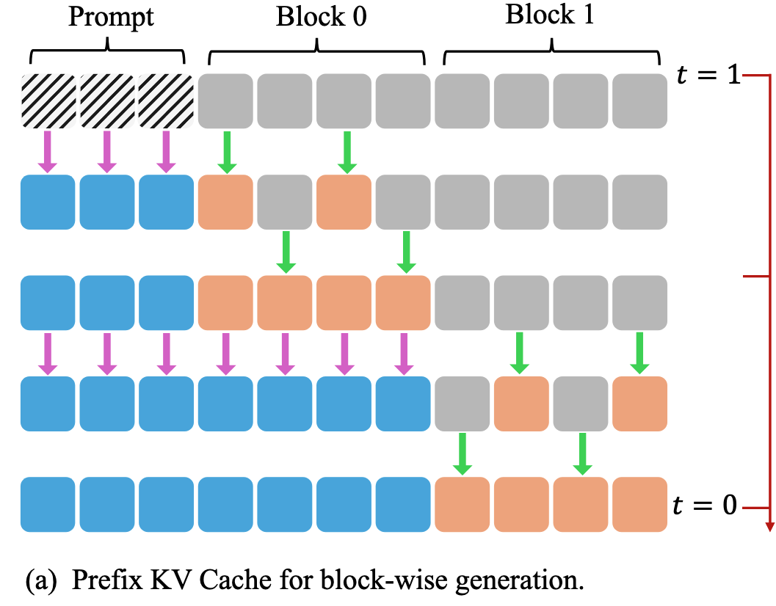
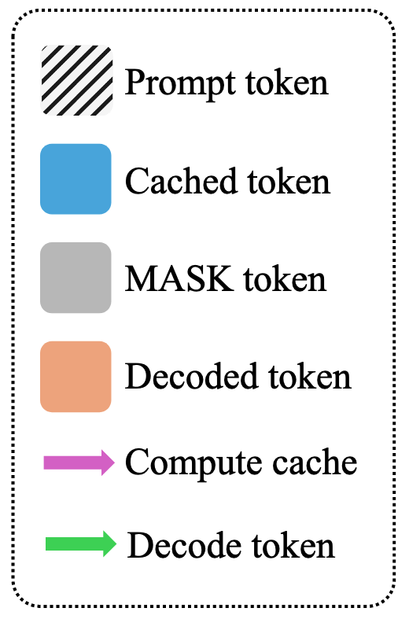
Approximate KV caching in Fast-dLLM
Fast-dLLM speeds up DLM inference via
  Approximate KV caching
  Confidence-aware parallel decoding
For approximate KV caching, Fast-dLLM adopts semi-AR sampling
Initial caching
Cache refresh
Initial caching
Wu et al., 2025, Fast-dLLM: Training-free Acceleration of Diffusion LLM by Enabling KV Cache and Parallel Decoding

Slide 21
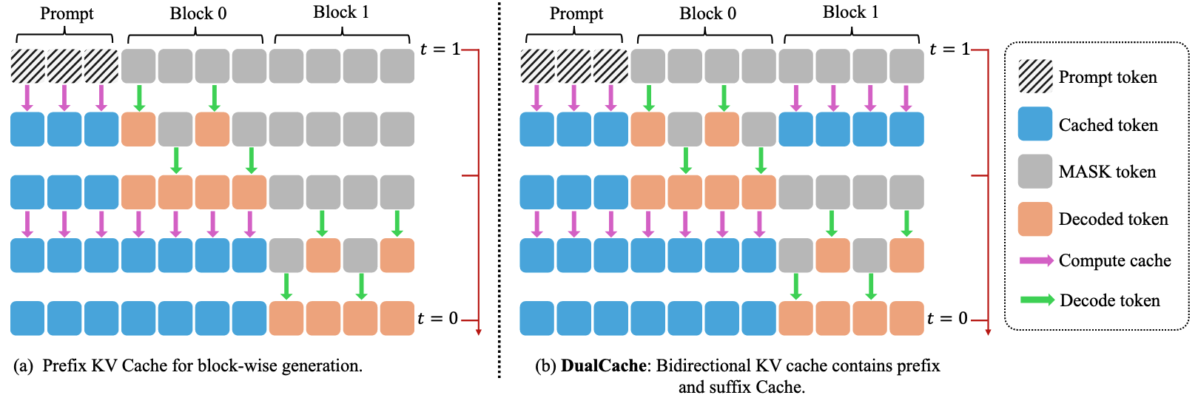
Approximate KV caching in Fast-dLLM
Same could be done for mask tokens
Initial caching
Wu et al., 2025, Fast-dLLM: Training-free Acceleration of Diffusion LLM by Enabling KV Cache and Parallel Decoding

Slide 22
Approximate KV caching in DLMs
Exact KV caching (AR-like) is impossible in DLMs
But what is the rationale behind KV caching? Can we really skip the computation?

Slide 23
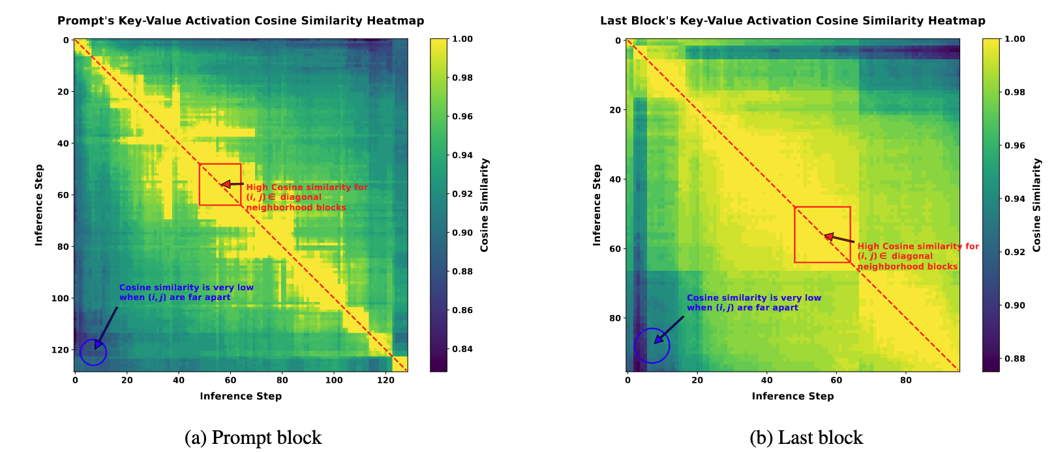
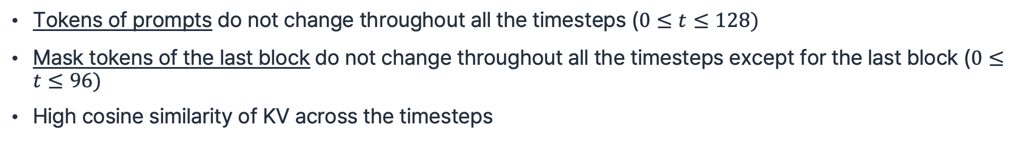
Approximate KV caching in DLMs
Tokens of prompts do not change throughout all the timesteps ($0≤t≤128)$
Mask tokens of the last block do not change throughout all the timesteps except for the last block ($0≤t≤96)$
High cosine similarity of KV across the timesteps
LLaDA-Instruct,
averaged over all tokens of prompt/last block
Wu et al., 2025, Fast-dLLM: Training-free Acceleration of Diffusion LLM by Enabling KV Cache and Parallel Decoding

Slide 24
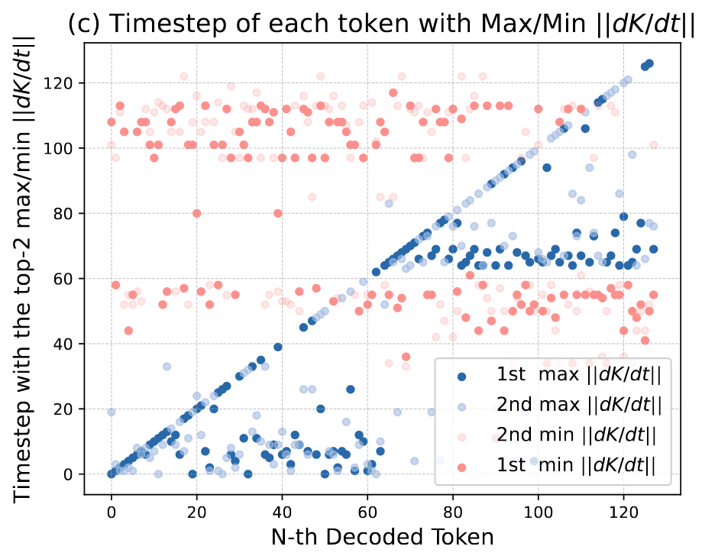
Approximate KV caching in DLMs
Journey of every decoded token of MDLM:
  <M> → <M> → … → <M> → 47 → 47 → … → 47
KV changes most significantly for timesteps
  where the token is decoded(unmasked)
  in the beginning of each block
KV changes the least for timesteps
  in the end of each block
LLaDA, gen_len = 128, timestep = 128, block size= 64
Ma et al., 2025, dKV-Cache: The Cache for Diffusion Language Models

Slide 25
Long context + DLM = 🐌
AR LM decoding time complexity
  Transformer with KV caching: O(n)
  => O(n^2)
DLM decoding time complexity
  Transformer w/o KV caching: O(n^2)
    If we linearly scale up timesteps with n, we get O(n^3)
  Keeping DLM decoding time complexity to O(n^2) requires either
    O(1) parallel decoding
    KV cache of only O(1) tokens are re-computed (“dKV-Cache-Greedy”, Ma+ ‘25)
Ma et al., 2025, dKV-Cache: The Cache for Diffusion Language Models

Slide 26
Block diffusion: hybrid of diffusion and AR

Slide 27
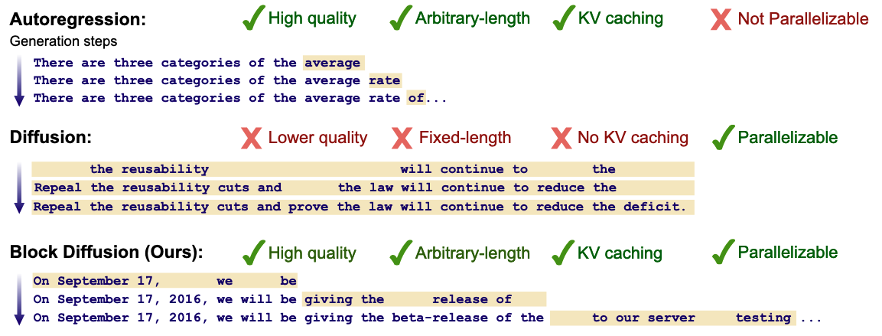
Block diffusion
Block diffusion(a.k.a. BD3-LM) (ICLR ‘25 Oral)
Hybrid of diffusion and AR
  Diffusion within each block
  AR across the blocks
Arriola et al., 2025, Block Diffusion: Interpolating Between Autoregressive and Diffusion Language Models

Slide 28
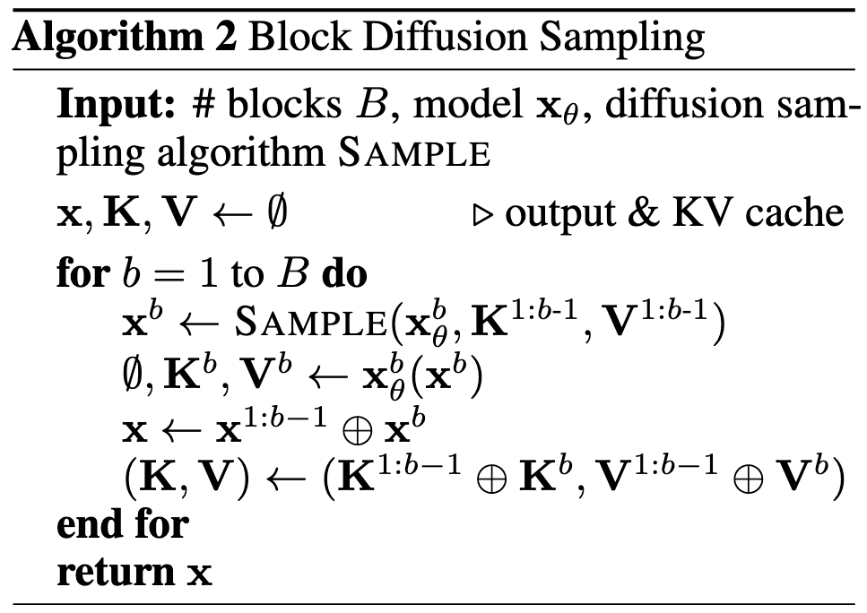
Block 1
<M> | <M>
t=1
1st forward pass:
For denoising block 1
Input: masked tokens [<M>, <M>]
Output: denoised tokens [B, A]
<M> | A
B | A
t=0
2nd forward pass:
For KV caching block 1
Input: clean tokens [B, A]
Output: KV of [B, A] via bidirectional attention
KV_B
KV_A

Slide 29
Block 1
<M> | <M>
t=1
<M> | A
B | A
t=0
KV_B
KV_A
<M> | <M>
t=1
C | <M>
KV of previous blocks
does not change!
(so it can be cached)
C | D
t=0
KV_C
KV_D

Slide 30
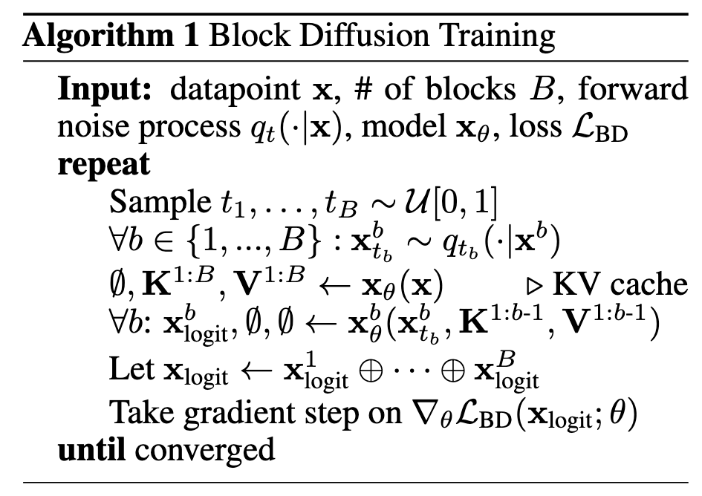
1) Pre-compute KV cache of clean tokens
A | B | C
D | E | F
DLM forward pass with block causal attention
2) Random noise to each block
KV
KV
<M> | <M> | C
D | <M> | F
t~
U[0,1]
All blocks done with single DLM forward pass
A | B | C
D | E | F
t=0
3) Apply MDLM loss on denoised tokens

Slide 31
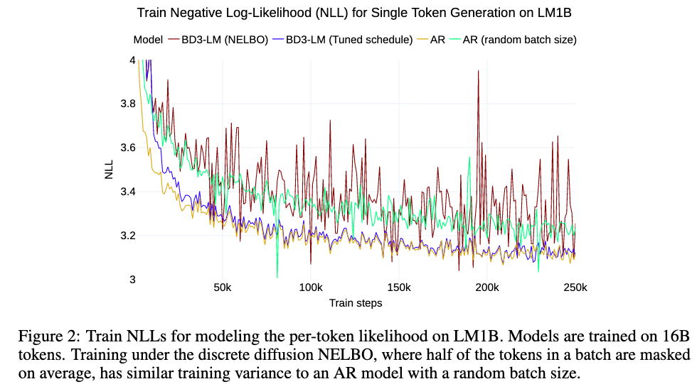
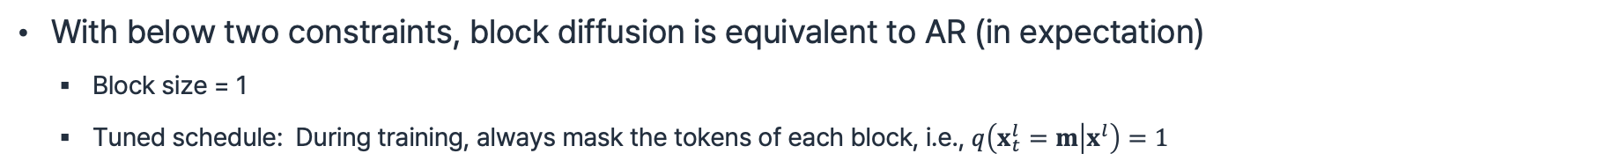
Block diffusion is very much like AR
With below two constraints, block diffusion is equivalent to AR (in expectation)
  Block size = 1
  Tuned schedule: During training, always mask the tokens of each block, i.e., $q\left(x_{t}^{l}=m | x^{l}\right)=1$
Vanilla BD3-LM and AR with random batch size show higher variance
(both shows inconsistent #(unmasked tokens) per step)
NLL curve of BD3-LM (Tuned schedule) == AR

Slide 32
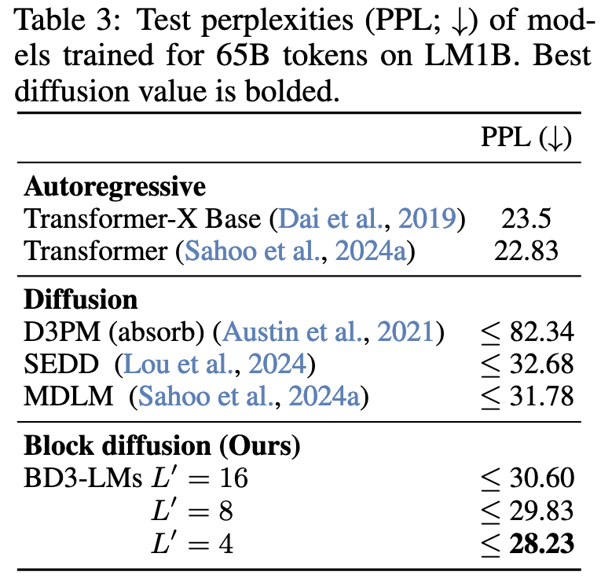
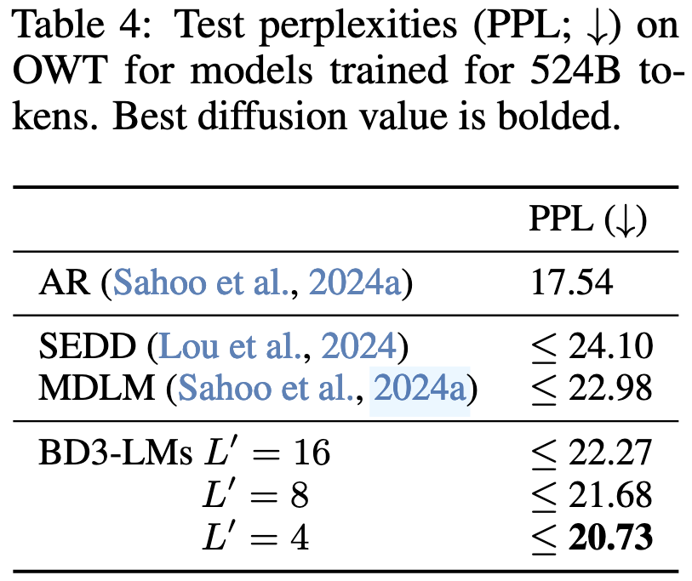
Block diffusion -- results
L’ = block size
context_length = 128
context_length = 1024

Slide 33
Now you can differentiate between
LLaDA’s semi-AR sampling vs block diffusion’s semi-AR sampling
Intra-block (approximate) KV caching vs inter-block (exact) KV caching
https://github.com/ML-GSAI/LLaDA/blob/main/GUIDELINES.md

Slide 34
Post-training

Slide 35
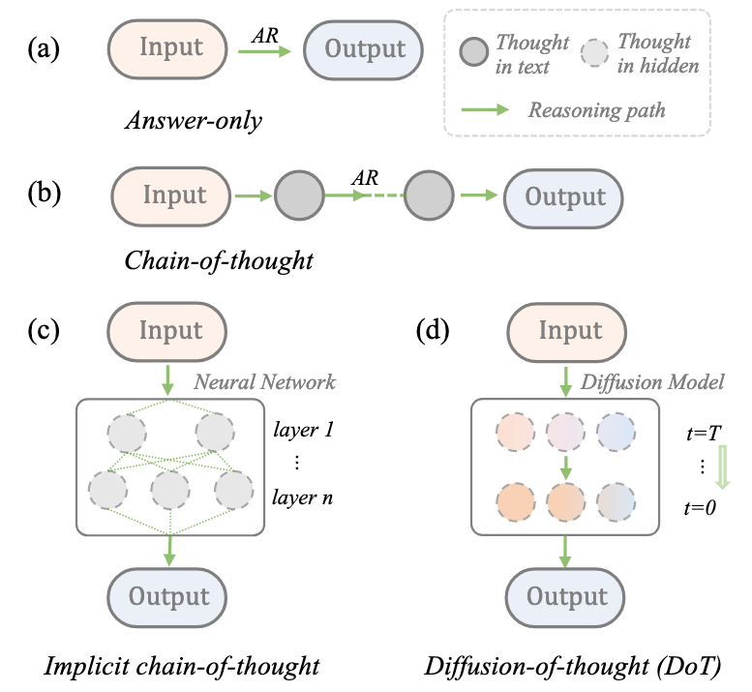
Diffusion of Thought (NeurIPS ‘24)
AR LMs use chain-of-thought to solve hard problems. How can DLMs use similar approach?
Diffusion-of-thought(DoT) generates reasoning path along the diffusion timesteps
Ye et al., 2024, Diffusion of Thought: Chain-of-Thought Reasoning in Diffusion Language Models

Slide 36
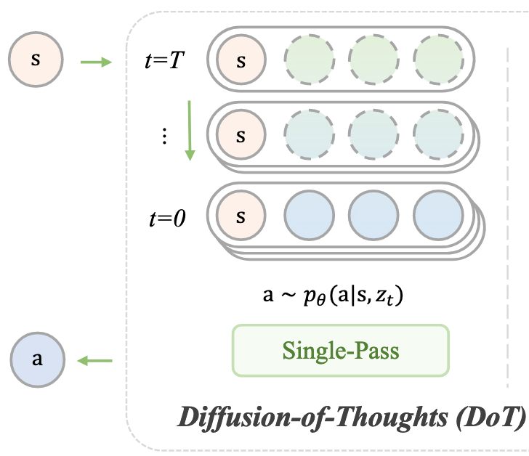
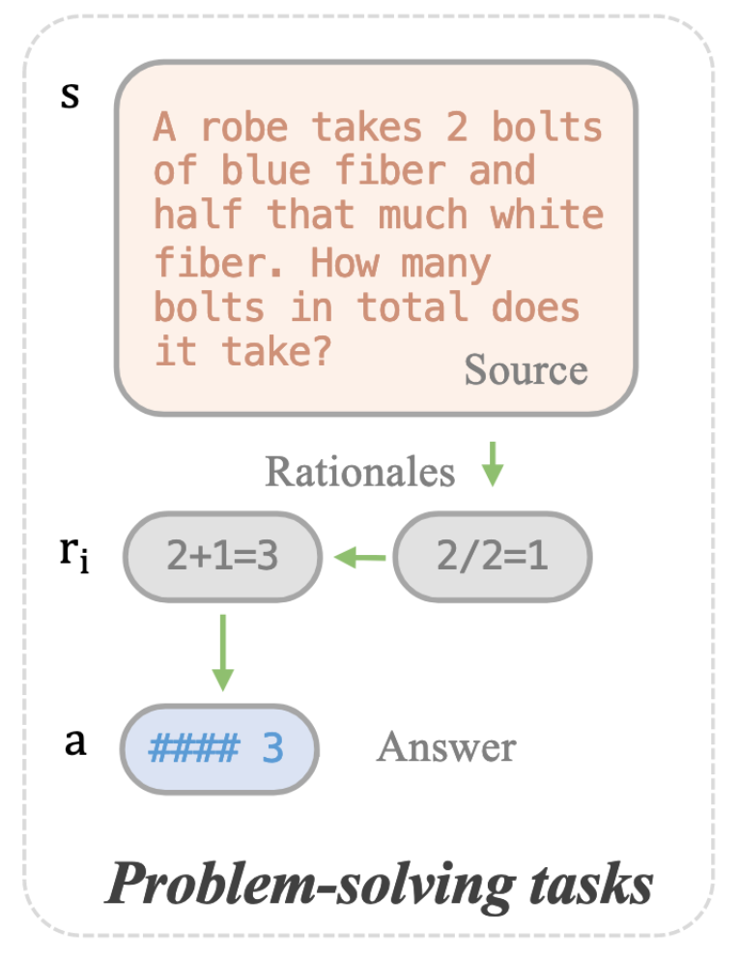
DoT -- modeling
Only the rationale tokens are noised
All rationales are generated in parallel
Ye et al., 2024, Diffusion of Thought: Chain-of-Thought Reasoning in Diffusion Language Models

Slide 37
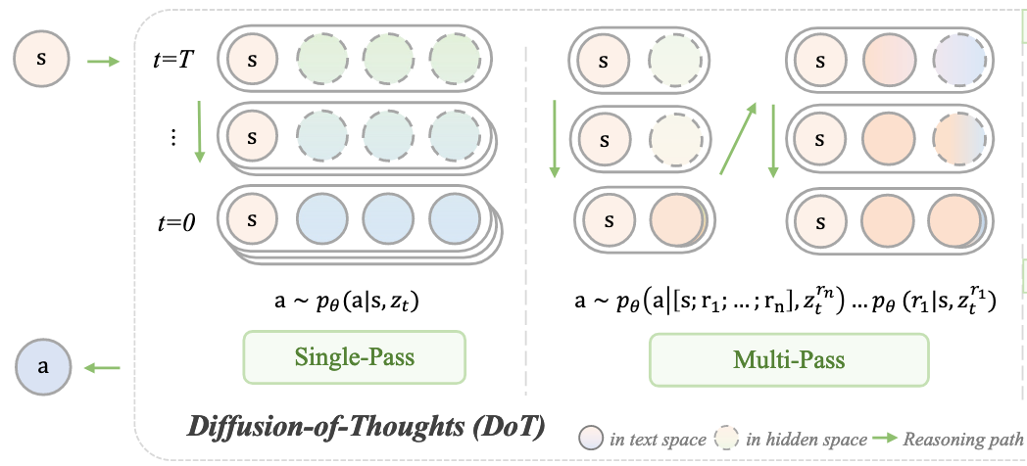
DoT -- modeling
Multi-pass DoT == semi-AR version
Ye et al., 2024, Diffusion of Thought: Chain-of-Thought Reasoning in Diffusion Language Models

Slide 38
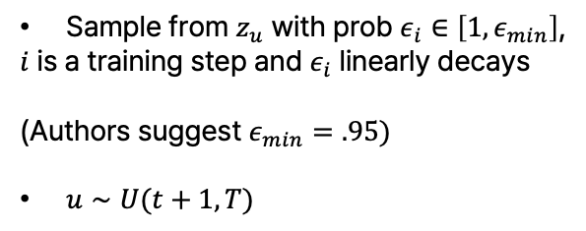
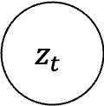
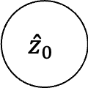
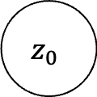
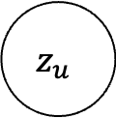
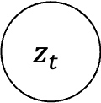
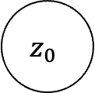
Training DoT
Scheduled sampling helps the model to recover from its reasoning errors
$$z_{u}$$
mimic the inference
$$z_{t}$$
$$z_{t}$$
Sample from $z_{u}$ with prob $ε_{i}∈\left[1,ε_{min}\right]$,
$i$ is a training step and $ε_{i}$ linearly decays
(Authors suggest $ε_{min}=.95)$
$u∼U(t+1, T)$
forward process
train reverse process
$$z_{0}$$
$$z_{0}$$
$${\hat{z}}_{0}$$
Without scheduled sampling
With scheduled sampling

Slide 39
Training DoT-MP
Coupled sampling helps the model to recover from its reasoning errors
  Add noise to not only the current block but also to the previous blocks
Ye et al., 2024, Diffusion of Thought: Chain-of-Thought Reasoning in Diffusion Language Models

Slide 40
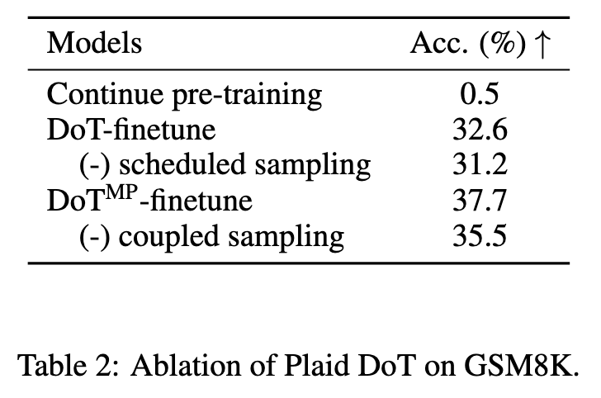
DoT -- result
DoT-MP (semi-AR) was better than DoT (non-AR)
  Coupled sampling helps in DoT-MP
GSM8K(math) favors left-to-right ordering, but for other tasks, semi-AR sampling may not have an edge
  Coding?

Slide 41
Post-training DLMs
DoT is the first work to present post-training for DLMs
  DoT = SFT on CoT dataset
In RL, applying GRPO for DLMs is challenging because obatining the log-likelihood of tokens (thereby sequences) is hard and inefficient
  In contrast, applying PPO seems to be more straightforward?

Slide 42
Estimating the likelihood of each token is hard in DLMs
There are so many paths to decode a single token. “Sampling” shows just one of many.
<-> In AR, there is one and only path to decode a single token.
<M> | <M> | <M> | <M> | <M> | <M>
<M> | <M> | <M> | <M> | <M> | <M>
.
.
<M> | <M> | <M> | <M> | <M> | F
A | B | C | D | E | <M>
A | B | C | D | E | F

Slide 43
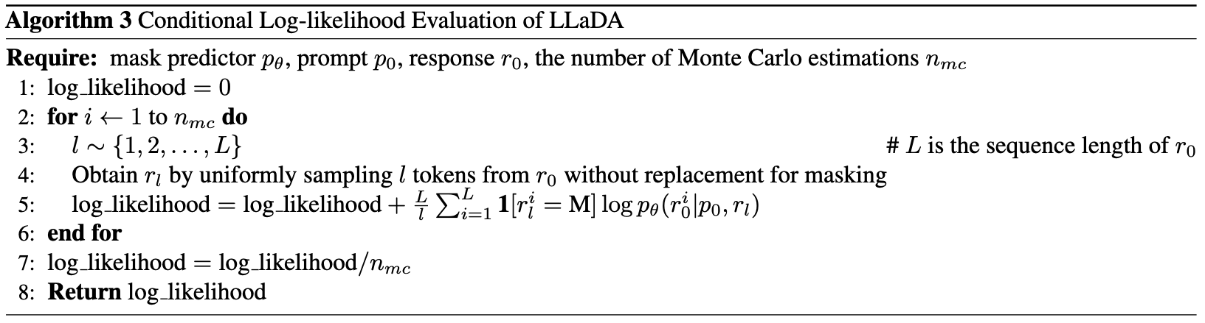
How to efficiently estimate
LLaDA uses Monte Carlo estimation with random maksing on response tokens
  c.f. LLaDA does not use GRPO, but algorithm for log-likelihood estimation is suggested
Problem? Monte Carlo estimation is too costly

Slide 44
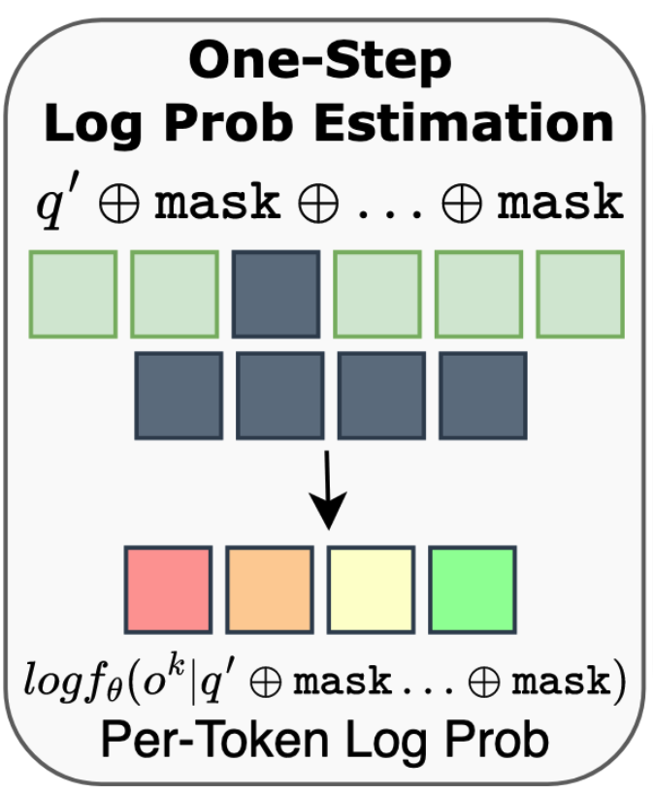
d1: estimation via one-step
Zhao et al., 2025, d1: Scaling Reasoning in Diffusion Large Language Models via Reinforcement Learning
d1 proposes diffu-GRPO, where log-likelihood of all tokens are estimated by a single unmasking process, i.e., t = T -> t =0
Log-likelihood of the sequence is simply a sum of the log-likelihood of all tokens

Slide 45
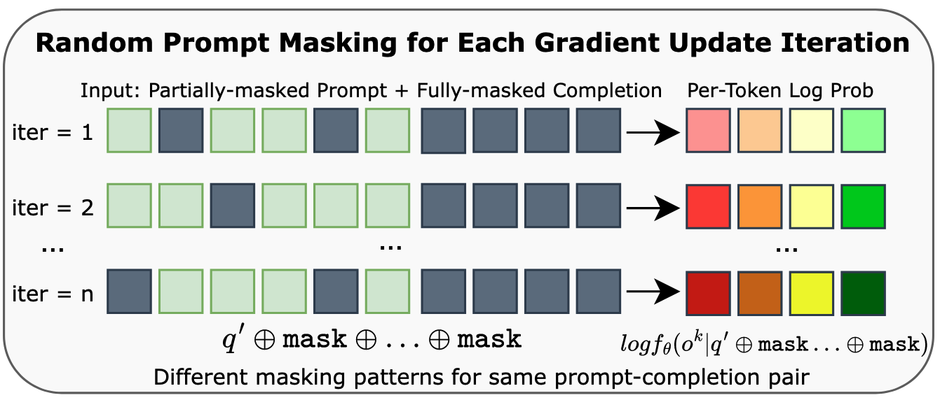
Mask the prompt?
d1 also masks 15% of prompt tokens
  d1 claims that this serves as a regularization for policy optimization
This is later rejected by DiffuCoder (Gong+ ‘25)
  DiffuCoder reports no yield in stable reward improvement
  Difference: math(d1) vs coding(DiffuCoder)
Zhao et al., 2025, d1: Scaling Reasoning in Diffusion Large Language Models via Reinforcement Learning

Slide 46
References
Sampling
  Nie et al., 2025, Large Language Diffusion Models
  Wu et al., 2025, Fast-dLLM: Training-free Acceleration of Diffusion LLM by Enabling KV Cache and Parallel Decoding
  Ma et al., 2025, dKV-Cache: The Cache for Diffusion Language Models
  Arriola et al., 2025, Block Diffusion: Interpolating Between Autoregressive and Diffusion Language Models
Post-training
  Ye et al., 2024, Diffusion of Thought: Chain-of-Thought Reasoning in Diffusion Language Models
  Zhao et al., 2025, d1: Scaling Reasoning in Diffusion Large Language Models via Reinforcement Learning
  Gond et al., 2025, DiffuCoder: Understanding and Improving Masked Diffusion Models for Code Generation

Slide 47


Yejoon Lee
leeyejoon@snu.ac.kr

